Slide 1
sdmay19-23 presents:
Mobile, Biometric Bitlocker
Advisor and Client: Dr. Akhilesh Tyagi and Timothy Dee
http://sdmay19-23.sd.ece.iastate.edu/
Notes:
Everyone introduce yourself: name and major.

Slide 2
sdmay19-23: Mobile, Biometric Bitlocker
Problem Statement
Problem:
Android phones lack a Trusted Platform Module (TPM).
Encryption keys must be stored somewhere somehow.
If the keys are stored on the devices, they can be found and could fall into malicious hands.
Solution:
Dynamically generate the key using a Physical Unclonable Function (PUF).
Notes:
Yousef

Slide 3
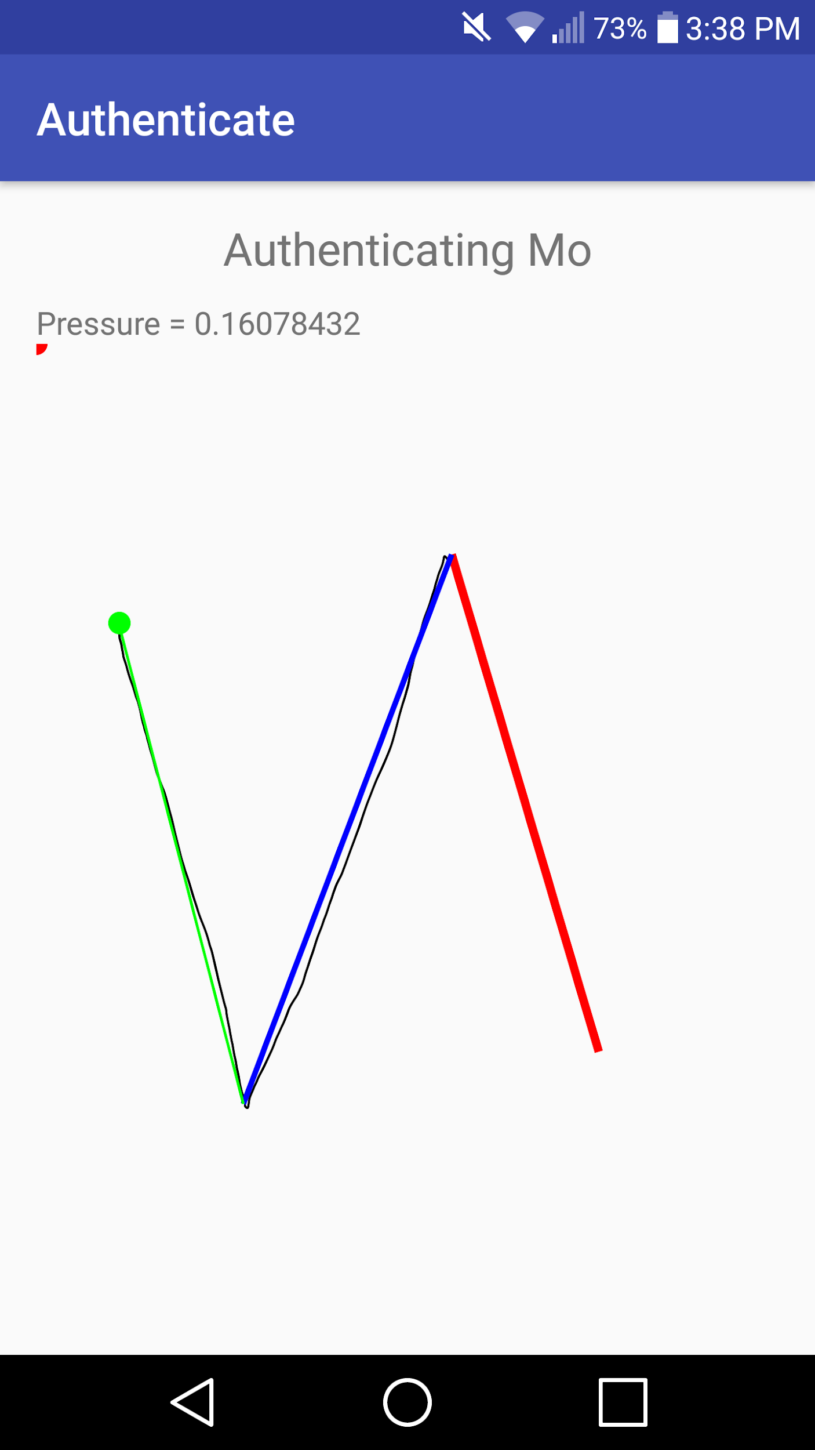
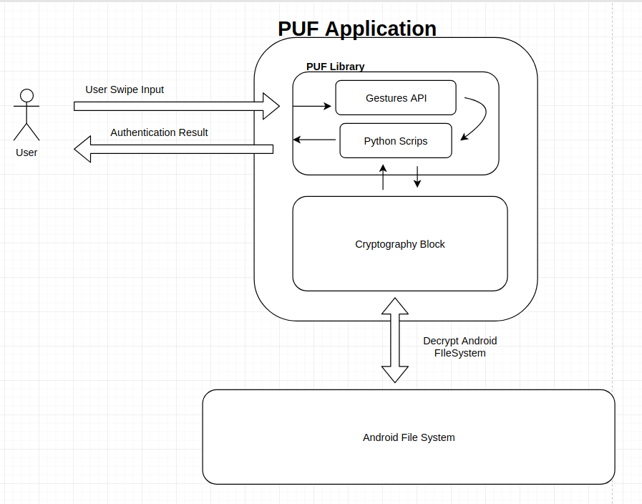
sdmay19-23: Mobile, Biometric Bitlocker
Initial Conceptual Sketch
Python Scripts
Notes:
Yousef: talk about components

Slide 4
sdmay19-23: Mobile, Biometric Bitlocker
Requirements Specification
Notes:
It is Justin’s time to shine.

Slide 5
sdmay19-23: Mobile, Biometric Bitlocker
Functional Requirements
Application should encrypt and decrypt data without corruption.
Only an authenticated user may access data.
Encryption continues when phone is locked.
Authentication required when an application is opened.
Notes:
Justin

Slide 6
sdmay19-23: Mobile, Biometric Bitlocker
Non-Functional Requirements
Application can store multiple user profiles.
Response time for authentication takes no longer than 5 seconds.
Gitlab repository should generate the application APK automatically.
Only the creator can unlock their profile.
Authentication accuracy of at least 80%.
Notes:
Justin

Slide 7
sdmay19-23: Mobile, Biometric Bitlocker
System Design and Development
Notes:
Ammar’s time to shine.

Slide 8
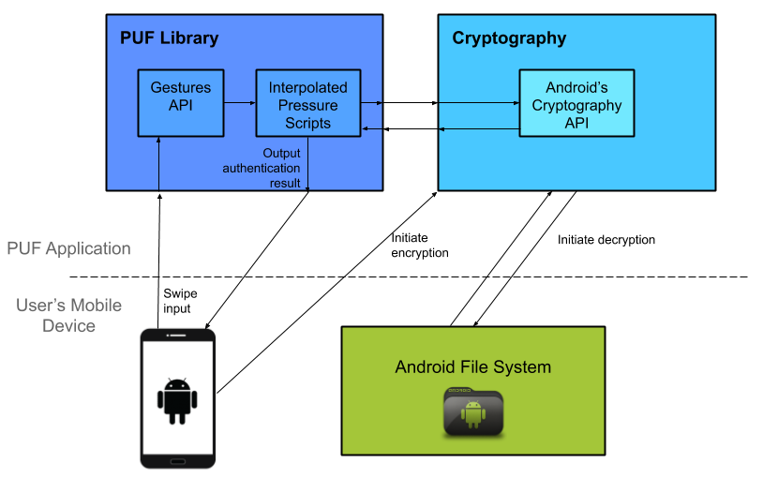
sdmay19-23: Mobile, Biometric Bitlocker
System Design
Python Scripts
Notes:
Ammar

Slide 9
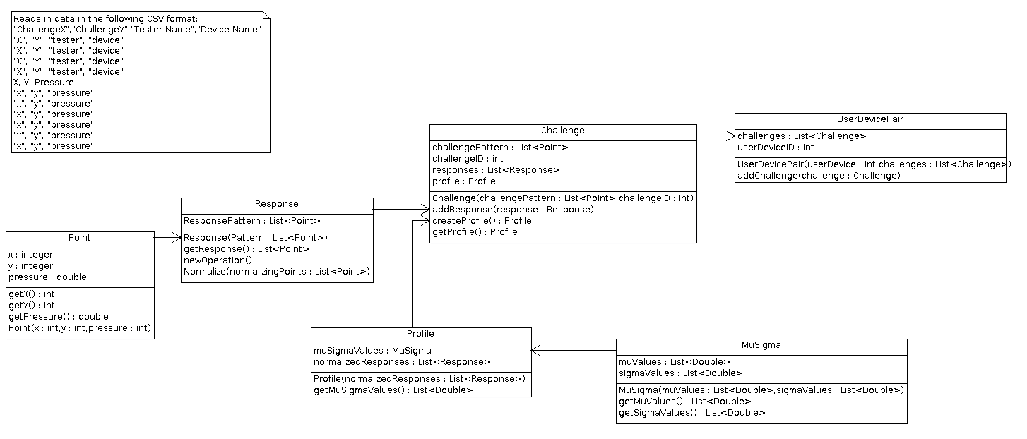
sdmay19-23: Mobile, Biometric Bitlocker
PUF UML
Notes:
Ammar

Slide 10
sdmay19-23: Mobile, Biometric Bitlocker
PUF Library Decomposition
Gestures API
Reads data from user-device gesture interaction
Creates user device pair
Provides challenges
User completes challenges
Challenges create profile
User-device pair created from list of challenges and their responses
Interpolated pressure scripts
Performs various statistical analyses and operations
Normalized trace: represent each trace as a set of pressure values at certain points
Authenticate based on normalized trace
Notes:
Ammar

Slide 11
sdmay19-23: Mobile, Biometric Bitlocker
Cryptography Block
Android cryptography API is used for encryption
Have researched dm-crypt and fscrypt for kernel level
Attempting to mimic Trusted Platform Module (TPM) on computers
Client’s end goal is to encrypt at the kernel level like Windows Bitlocker (full-disk encryption)
Started with application-level encryption
Progressively researched and experimented with encrypting at lower levels
Kernel-level encryption deemed infeasible
Notes:
Ammar:

Slide 12
sdmay19-23: Mobile, Biometric Bitlocker
System Requirements
Software
Android Operating System
Minimum Version 5.1 (Lollipop)
Hardware
Should be able to be run on any hardware that is running required Android Version
Should have a touch screen
Operating Environment
Nexus 7
Notes:
Ammar
To better control variables in the project, testing is completed on Nexus 7 SDK 23

Slide 13
sdmay19-23: Mobile, Biometric Bitlocker
Implementation

Slide 14
sdmay19-23: Mobile, Biometric Bitlocker
Prototype

Slide 15
sdmay19-23: Mobile, Biometric Bitlocker
Final Implementation

Slide 16
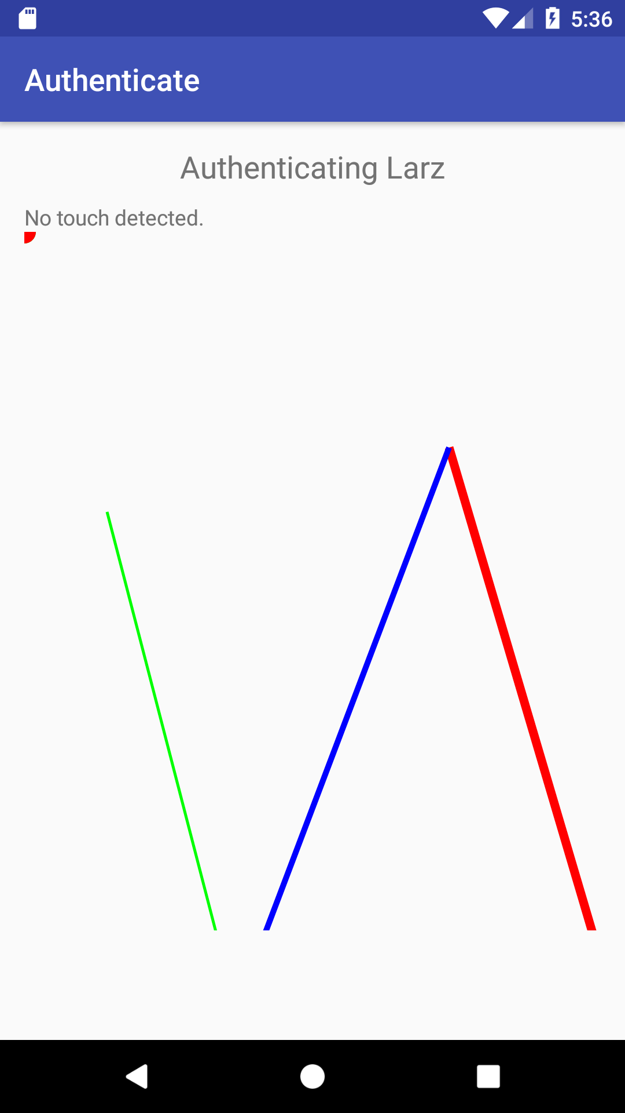
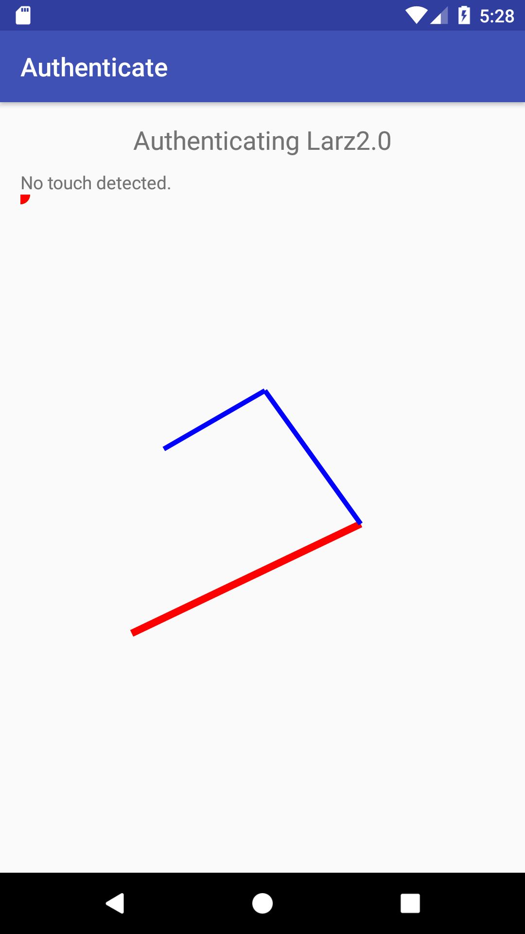
sdmay19-23: Mobile, Biometric Bitlocker
PUF Library
Fixed implementation
Fixed trace pattern
Notes:
Larisa

Slide 17
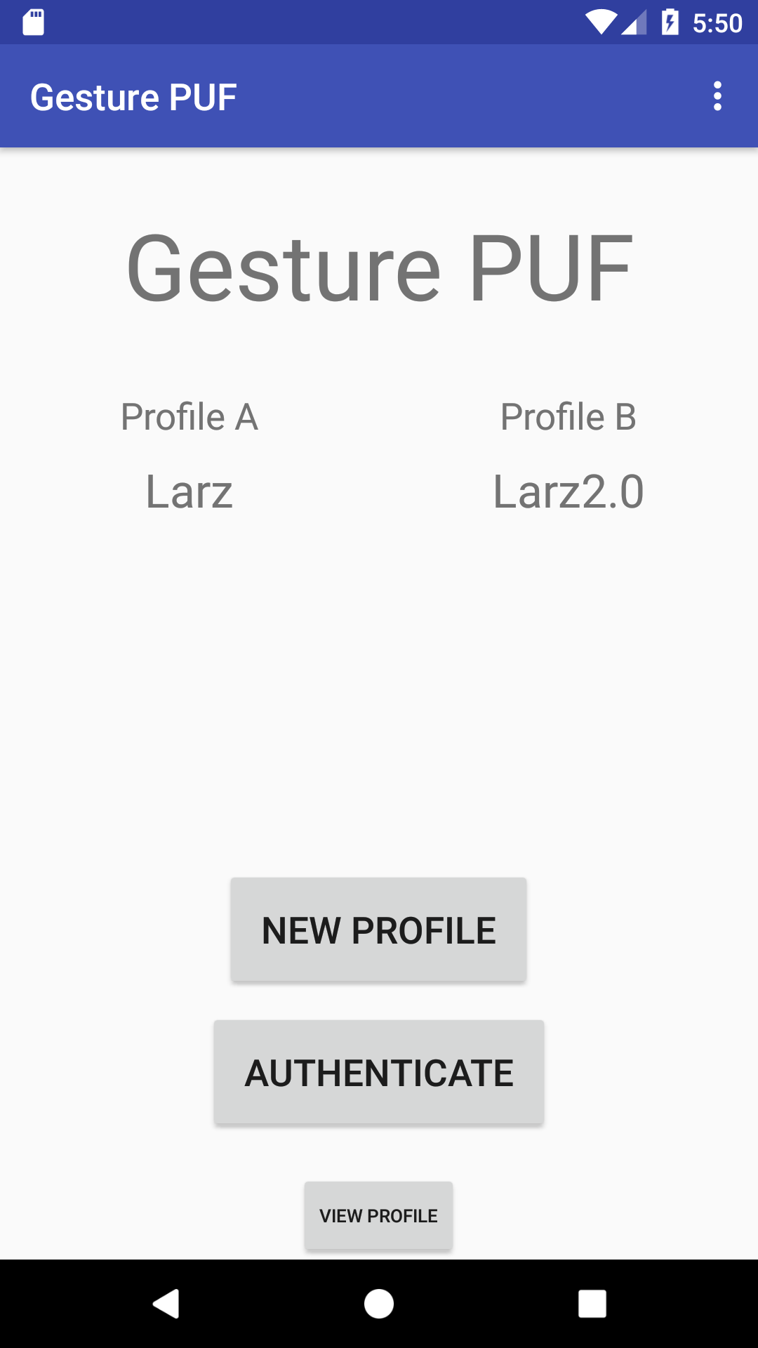
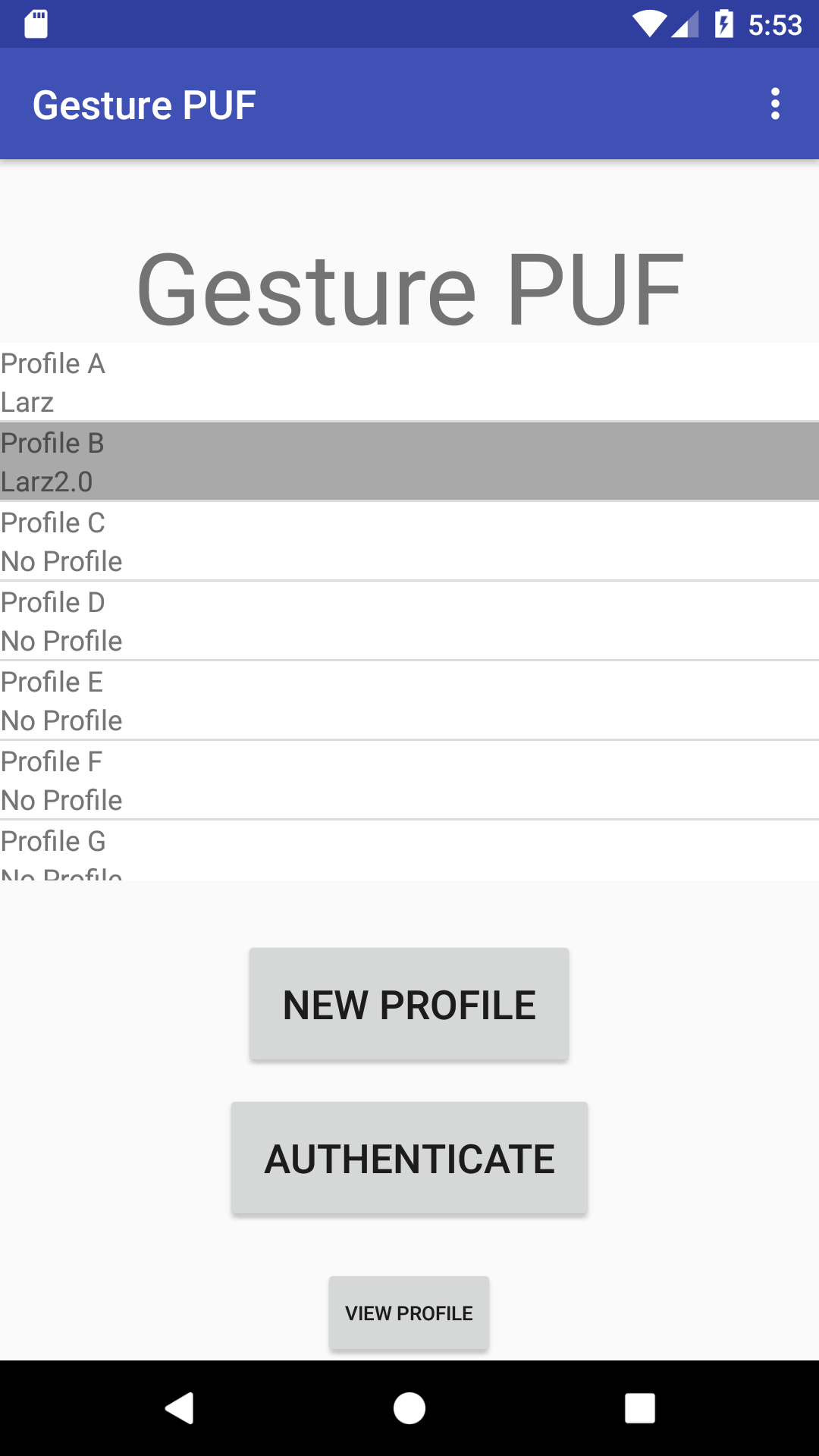
sdmay19-23: Mobile, Biometric Bitlocker
Encryption and Mobile Application
Added ability to encrypt and decrypt using a dynamically generated key
Added multiple profiles
Notes:
Larisa

Slide 18
sdmay19-23: Mobile, Biometric Bitlocker
Rationale
PUF design decisions
The only decisions we were apart of was rewriting internal scripts.
We wrote internal Python scripts in Java.
To fix them and for easier use in kernel.
Stopping at application level
We decided to stop at application level due to PUF library issues.
We were spending more time updating and fixing PUF than on implementing other features.
No straightforward way to integrate at kernel level.
Notes:
Larisa

Slide 19
sdmay19-23: Mobile, Biometric Bitlocker
Testing, Validation and Evaluation

Slide 20
sdmay19-23: Mobile, Biometric Bitlocker
Test Plan
Unit Testing
Designed simultaneously during development
Tests core functionality of a component
Integration Testing
Created when combining between multiple components
Designed to test specific interactions between two components
System Testing
Full operational behavior of the application with actual data
Largely performed towards the end of project
Notes:
Justin

Slide 21
sdmay19-23: Mobile, Biometric Bitlocker
Sample Test Cases
Only authenticated users may access user application data
User A has authentication profile
User A and B complete authentication trace
Only User A with an authentication profile is allowed
Response time of authentication should take less than 5 seconds
User A completes authentication trace
Authentication process notifies user A results in under 5 seconds
Notes:
Justin

Slide 22
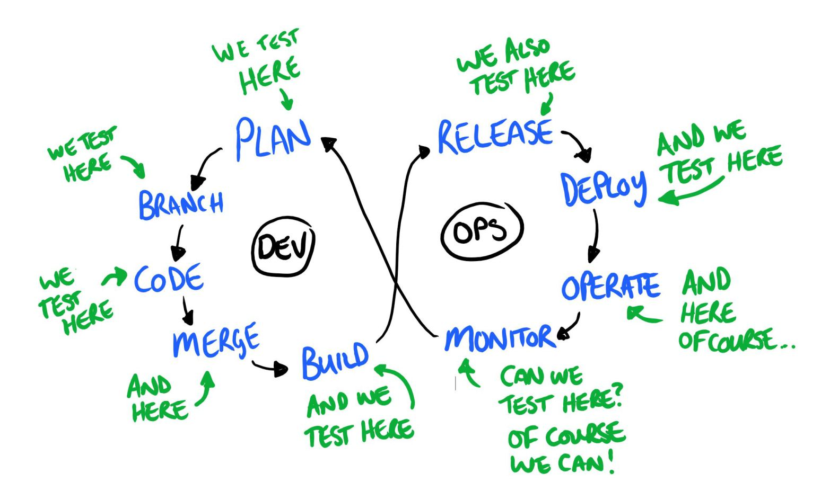
sdmay19-23: Mobile, Biometric Bitlocker
DevOps
Tests:
Pull Requests
Merges to master
Builds:
JAR (PUF)
APK (App)
Deployments:
Google Play Store
Source: https://www.testingexcellence.com/testing-in-devops/
Notes:
Yousef

Slide 23
sdmay19-23: Mobile, Biometric Bitlocker
Project and Risk Management
Notes:
Morgan’s time to shine:
Now I will walk you through what we did for project and risk management

Slide 24
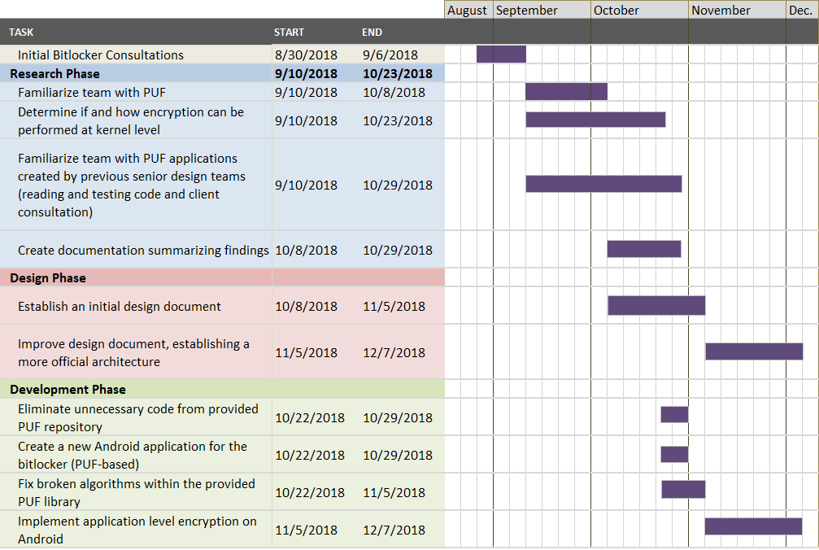
sdmay19-23: Mobile, Biometric Bitlocker
Project Schedule - Fall 2018
Notes:
Morgan
To carry out this project, we decided right off the bat to base our schedule on the rolling wave planning technique, which allowed us to discuss and make decisions as the project progressed. After our initial consultation with our client, we determined that we wanted to split our project into 5 phases: research, design, development, testing and, finally, delivery. As you can see in this chart, a majority of our project last semester consisted of researching various concepts essential to developing this application and establishing a sound design to guide us in the development phase.
In terms of research, we spent the first two months familiarizing the team with the concept of a PUF, encryption techniques and the PUF applications provided by our client. Our investigations, unfortunately, showed that the applications provided were a little flawed, meaning we found several errors within the provided library. As a result, we determined a few milestones that we hoped to complete by the end of December, including fixing the broken algorithms within the PUF library and implementing a working encryption application using PUF at the application level.

Slide 25
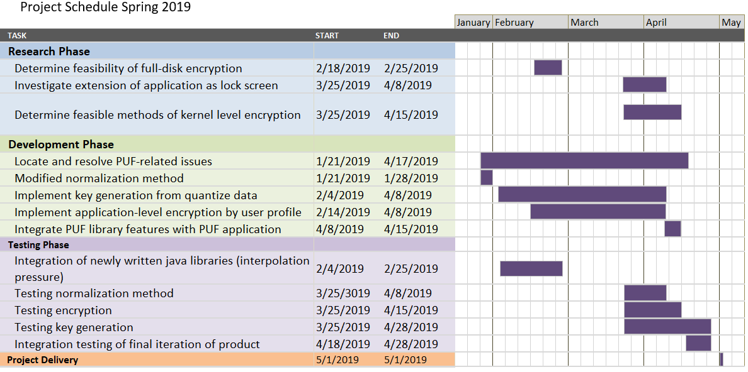
sdmay19-23: Mobile, Biometric Bitlocker
Project Schedule - Spring 2019
Notes:
Morgan
Unfortunately, we were unable to achieve either of these goals last semester due to a constant influx of issues from the PUF library and how normalization was functioning as a result of the project structure. So, at the beginning of this semester, our project underwent a scope change, where fixing the PUF library became a priority. Once we resolved enough issues with the library, our team began to spread out into different areas of the project. Some member began implementing new features, such as key generation and encryption, others re-entered the research phase to investigate what was needed to achieve our updated functional requirements, while the remainder continued work on fixing the PUF library. As more features were completed, our team slowly began following our test plan to verify our features worked as the client expected, doing so until our hard delivery deadline, which is today.
Potential questions from the panel:
What were some of the fixes your team made to the PUF?

Slide 26
sdmay19-23: Mobile, Biometric Bitlocker
Risks and Mitigation
Integrating preexisting PUF library
Library is heavily hard-coded
Allocate time
Inaccurate authentication
PUF must be at least 80% accurate
The library has multiple methods of normalization, authentication, etc.
Implementing full-disk encryption
Android switched to file-based encryption
Workaround is possible through previous versions of Android
Notes:
Cole

Slide 27
sdmay19-23: Mobile, Biometric Bitlocker
Setbacks and Mitigation
Inaccurate authentication
Consulted Technical Advisor, Timothy Dee
Remove need for Python interpreter
Rewrite Python scripts
Full-disk encryption infeasible
Linux Kernel library “fscrypt”
Encryption at application level
Notes:
Cole

Slide 28
sdmay19-23: Mobile, Biometric Bitlockers
Lessons Learned
Importance of facilitating communication early
Exploring a provided product in the initial stages of planning before moving forward in the project lifecycle
Notes:
Morgan
Considering all our experiences during this project, I think it is safe to say we learned a few lessons. Of these, two major lessons we learned were the importance of establishing communication early and exploring what is given before moving forward in the project lifecycle.
Regarding communication, we had a tendency to not communicate well, which caused many of our deadlines to be extended and project progress to slow down. To account for this, we established an accountability plan where members reached out to others to check on feature progress, which helped the team be more aware of what was happening and whether help was needed to meet a given deadline.
The other lesson we learned was verifying that the information learned about the project upon receipt was true before progressing in the project lifecycle. In other words, we assumed what the client initially told us about the PUF library was correct, so we went ahead with those assumptions when we were planning our project. We later found out those assumptions were wrong, causing us to backtrack and have to reestablish what our goals were. Although things worked out in the end, this type of scenario helped our team understand that we should always double-check what we are being told from our stakeholders to prevent misunderstandings and wasted time.
--------
Identify (1 sentence)
Describe plan (1 sentence)
Explain how plan helped solve communication (1-2 sentences)
Regarding communication, individuals had a tendency to not convey when assigned work would be realistically completed, meaning individuals would leave out what their personal schedules and circumstances looked like for a given week. We failed to communicate conflicts early, causing many of our deadline to be extended, which, in turn, caused project progress to slow way down and place stress on completing the project the way our client wanted it. To mitigate this, we learned that formulating some kind of accountability plan where members reach out to check on progress goes a long way, especially in helping members be more aware of what is happening and whether help is needed.

Slide 29
sdmay19-23: Mobile, Biometric Bitlocker
Conclusion
Notes:
Our goal for this project was to integrate existing software into an Android-based OS application. We will do this by research, design, development, testing and conferring with our client. We think this is a worthwhile project because the use of a pressure PUF as a bitlocker for a mobile device has not been done and will add needed security. We hope to complete the application in its entirety by the end of spring 2019.

Slide 30
sdmay19-23: Mobile, Biometric Bitlocker
What did we do?
Yousef Al-Absi
Understanding Gradle
Assisted with PUF issues
Implemented DevOps
Cole Alward
Implemented encryption
Assisted in application integration
Organized ticket flow
Morgan Anderson
Implemented key generation
Assisted in application integration
Aided in technical writing and schedule organization
Ammar Khan
Interacted with client
Assisted in rewriting interpolated pressure scripts
Aided others with PUF issues
Justin Kuhn
Developing test plan
Conducted test integration
Assisted in rewriting interpolated pressure scripts
Larisa Thys
Led semi-weekly meetings
Assisted in reworking authentication
Aided others with PUF issues
Notes:
Cole: state roles of everyone

Slide 31
sdmay19-23: Mobile, Biometric Bitlocker
Current Project Status
Completed Milestones:
Completed PUF research
Completed initial design of project
Integrated PUF into an application design
Created application that encrypts and decrypts
Maintained and updated PUF repository for future use
Notes:
Morgan
As a recap, our goal for this project was to integrate existing software, that is, the PUF, into an Android-based OS application for users to secure their data. Keeping this in mind, we have achieved our functional requirement milestones, including making the PUF library functional, establishing an application that encrypts and decrypts a user’s information using a dynamically generated key and successfully maintaining and updating the PUF repository for future use.
-----------
So what is the project looking like right now? Relative to milestones, we have complete the following milestones. We have finished our PUF research, we feel like we have a good handle on what it is. We have also completed our initial design for the project. We removed excess code from the PUF, there was 3000+ extra files that our project didn't need. Lastly we completed a initial integration of PUF into an Android project.
Application should encrypt and decrypt data without corruption.
Only an authenticated user may access data.
Encryption continues when phone is locked.
Authentication required when an application is opened.

Slide 32
sdmay19-23: Mobile, Biometric Bitlocker
Going Forward
Refine PUF library
Extend Android lock screen API to integrate PUF library
Implement kernel-level encryption to secure device at boot
Notes:
Cole:
Finally, what do we have to do next semester. Relative to milestones we have started some and have some full tasks left to do. We have started fixing bugs within PUF. We think we know all the issues and have a grasp on how to fix them. We also have started looking into adding encryption to our initial application.
What we have left to do next semester is to implement kernel level encryption, identify other things the client might want, and testing. No necessarily in that order.

Slide 33
sdmay19-23: Mobile, Biometric Bitlocker
Questions?
Notes:
Yousef: That's it for us. Do we have any questions?

