Slide 1
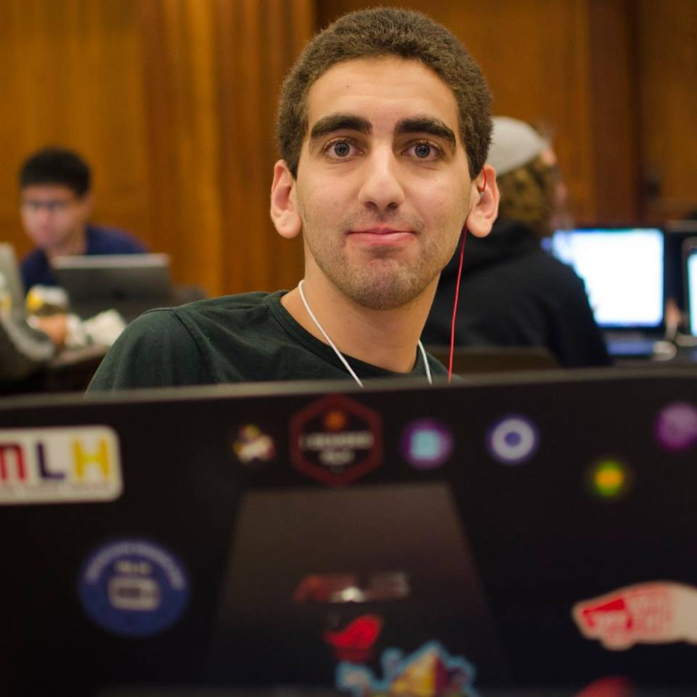
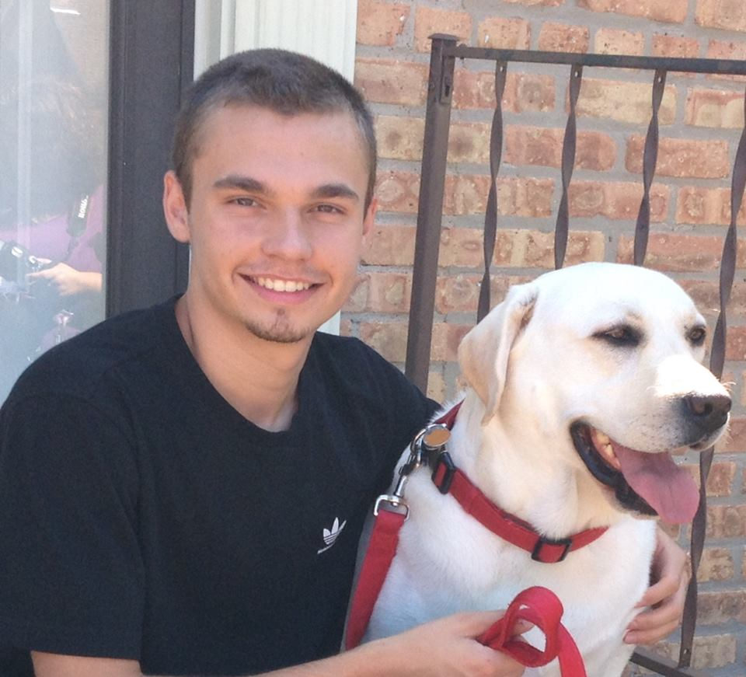
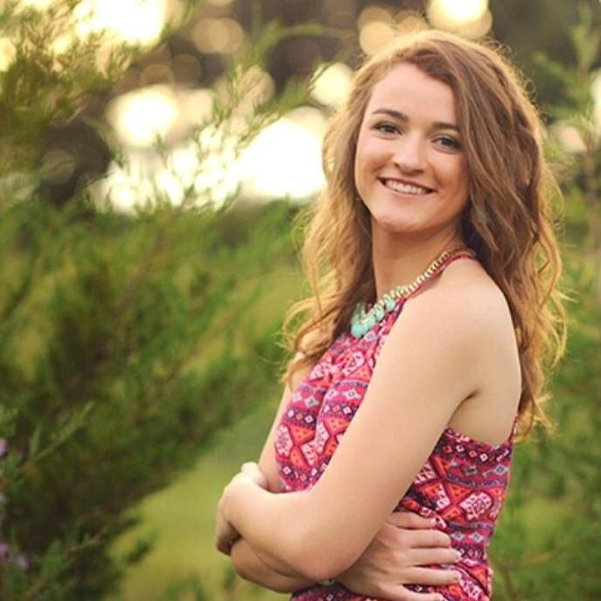
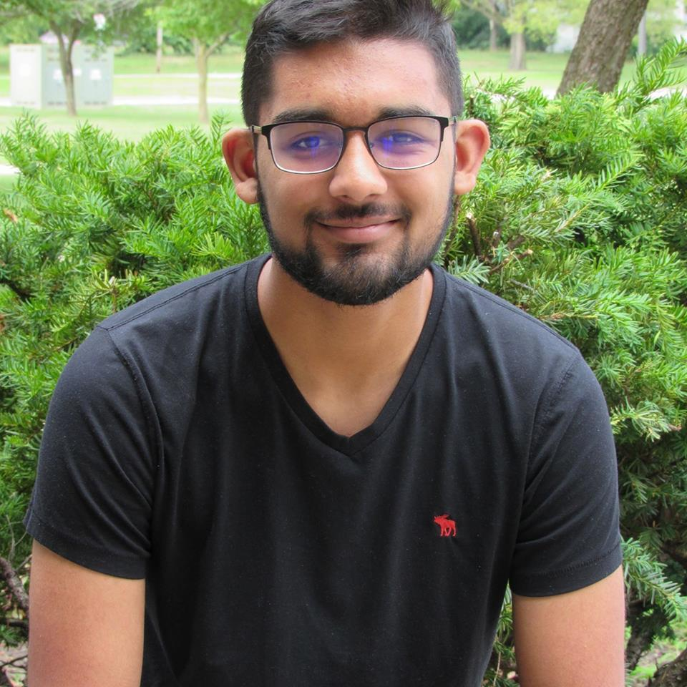
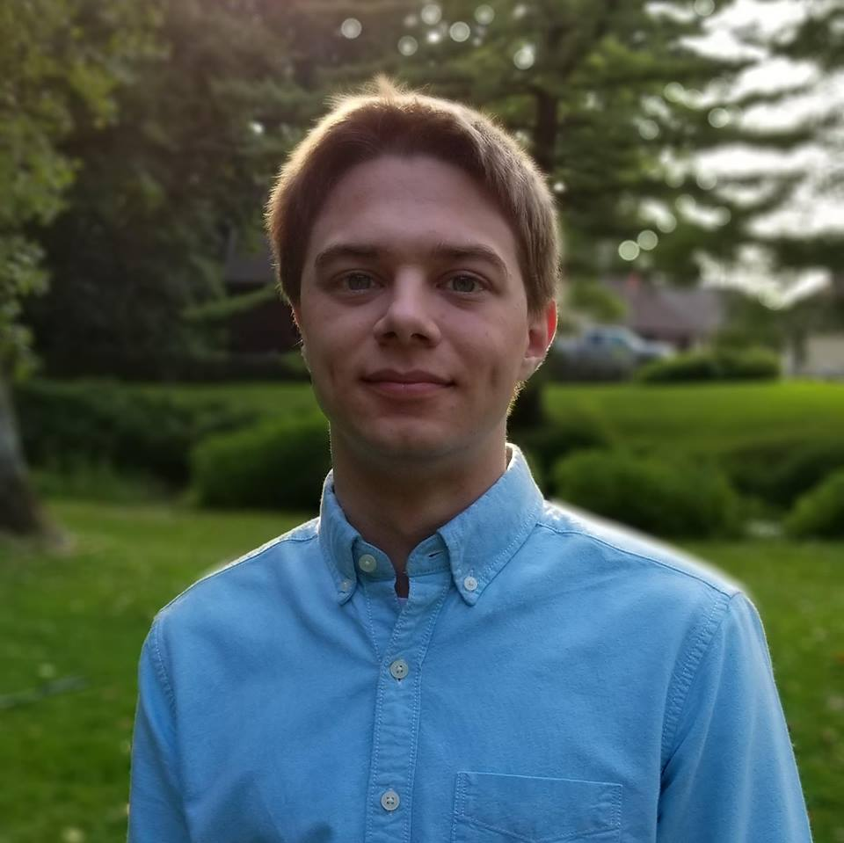
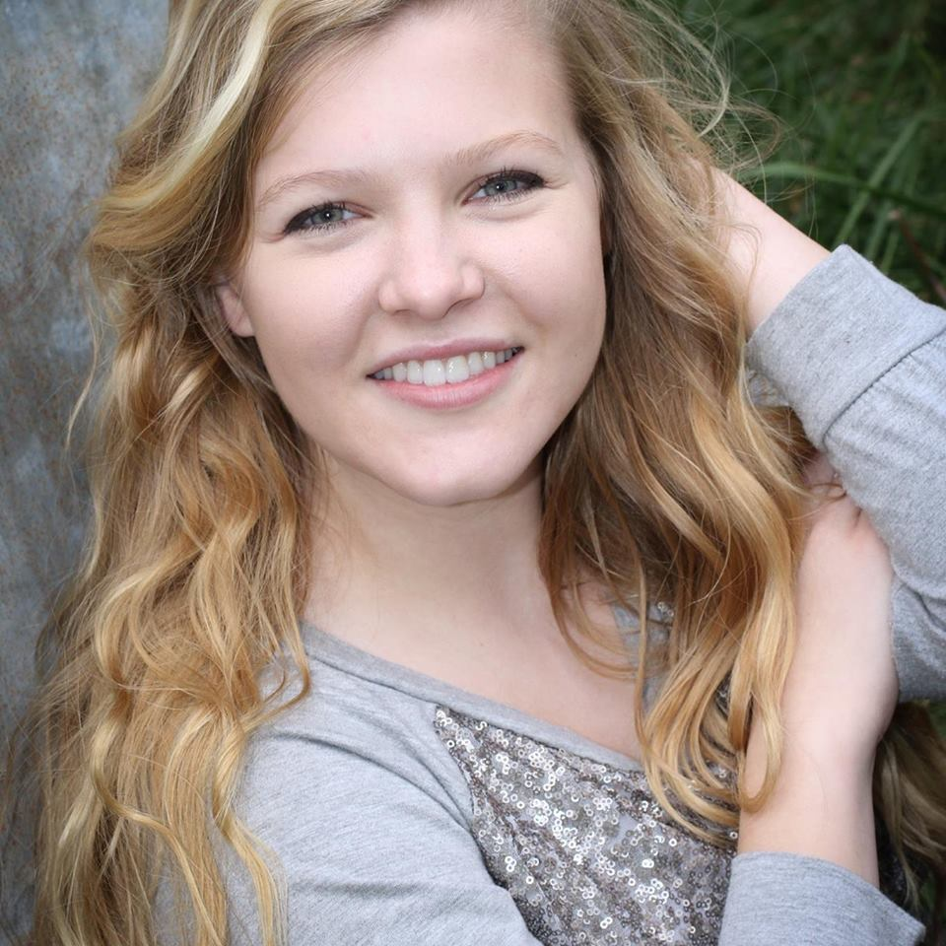
sdmay19-23 presents:
Mobile, Biometric Bitlocker
Advisor and Client: Dr. Akhilesh Tyagi and Timothy Dee
http://sdmay19-23.sd.ece.iastate.edu/

Slide 2
sdmay19-23: Mobile, Biometric Bitlocker
Project Plan

Slide 3
sdmay19-23: Mobile, Biometric Bitlocker
Problem Statement
Problem:
Android phones lack a Trusted Platform Module (TPM)
Encryption keys must be stored somewhere somehow.
If the keys are stored on the devices, they can be found and could fall into malicious hands.
Solution:
Dynamically generate the key using a Physical Unclonable Function (PUF).

Slide 4
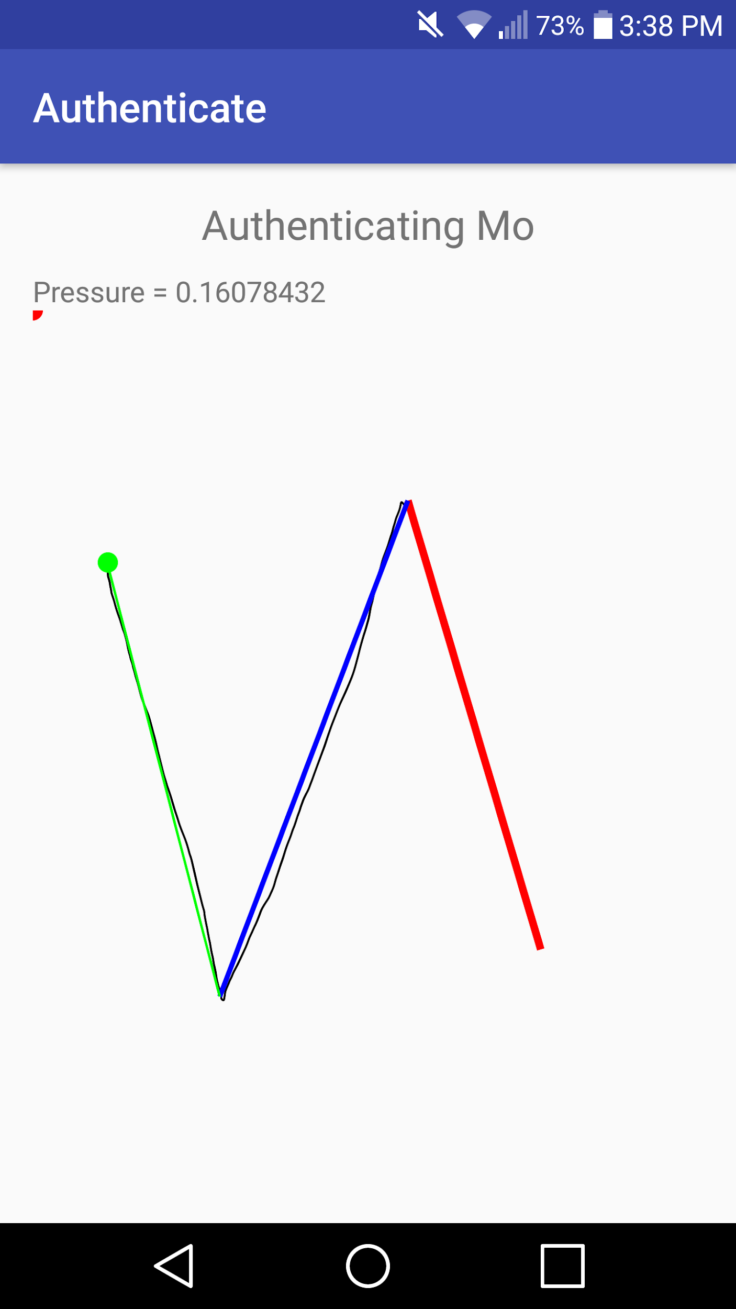
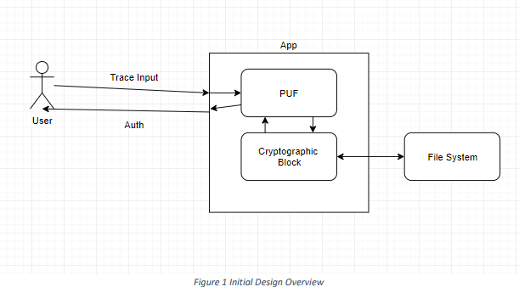
sdmay19-23: Mobile, Biometric Bitlocker
Conceptual Sketch

Slide 5
sdmay19-23: Mobile, Biometric Bitlocker
Functional Requirements
Only an authenticated user may access data
Device cannot be shut off while encrypting
Authentication required when an application is opened
Encrypt and decrypt data without corruption

Slide 6
sdmay19-23: Mobile, Biometric Bitlocker
Non-Functional Requirements
Application can store multiple user profiles
Response time of authentication takes no longer than 5 seconds
Repository should generate the application APK automatically

Slide 7
sdmay19-23: Mobile, Biometric Bitlocker
Market and literature survey of similar products
Fingerprint Scanner
Protects a user’s data by authorizing via the user’s fingerprint
Does not take advantage of slight hardware differences
New York University found you can break it 65% of the time
Microsoft Bitlocker
Usually implemented in laptops, not phones.
Usually uses outward device for authentication
Notes:
Now we will cover similar products on the market today. While through my research I have no found product exactly like our product there are some similar ones. The ones I will touch on today are the fingerprint scanner and microsoft's bitlocker. The fingerprint scanner is well known as most phones have them. It is similar to our product because it lets the user into the phone only if they are authenticated. Although in a survey that I read from New York University a “master fingerprint” can break this 65% of the time.
Also similar to our product is the Microsoft Bitlocker, this concept is what we hope our process will look like at the end. By encrypting the file system on the kernel level. Although right now this usually only implemented on laptops. It also will use a seperate device for authentication. For example at my work we use a usb device to authenticate the user.
Our hope is to take pieces from both of these products to create ours.

Slide 8
sdmay19-23: Mobile, Biometric Bitlocker
Risks and Mitigation
Integrating preexisting PUF library
Library is heavily hard-coded
Allocate time
Inaccurate authentication
PUF must be at least 95% accurate
The library has multiple methods of normalization, authentication, etc.
Implementing full-disk encryption
Android switched to file-based encryption
Workaround is possible through previous versions of Android

Slide 9
sdmay19-23: Mobile, Biometric Bitlocker
Resource Requirements
Software - Open Source
Java, Android Studio and Python
Hardware - Cost of phone or tablet
 | Device | Cost
1 | Nexus 7 | $199
2 | Nexus 7 | $199
 |  | Total: $398

Slide 10
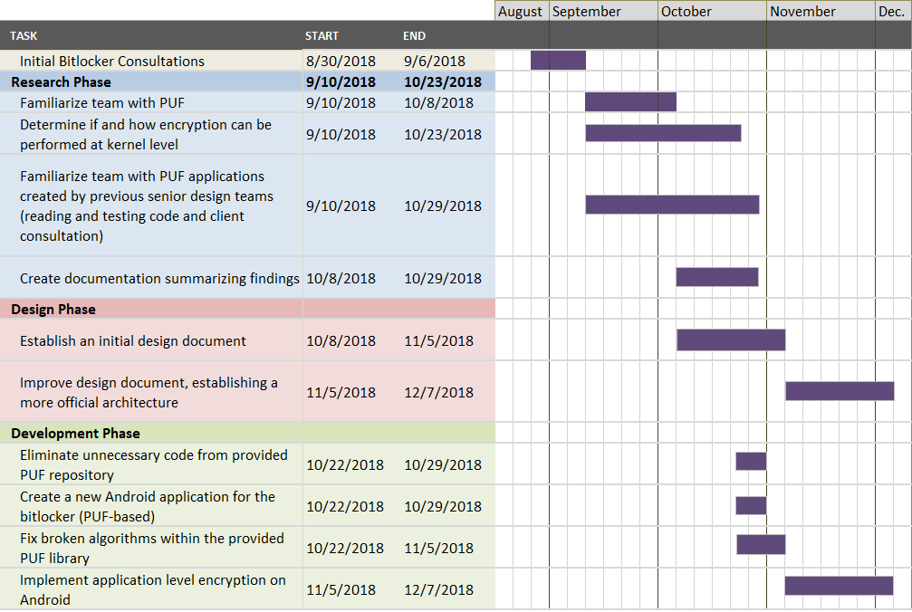
sdmay19-23: Mobile, Biometric Bitlocker
Project Schedule - Fall 2018
Notes:
To carry out this project, we decided right off the bat to base our schedule on the rolling wave planning technique, which allows us to discuss and make decisions as the project progresses. After our initial consultation with our client, we determined that we wanted to split our project into 5 phases: research, design, development, testing and, finally, delivery. As you can see in this chart, a majority of our project this semester consists of researching various concepts essential to developing this application and establishing a sound design to guide us in the development phase.
In terms of research, we spent the first two months familiarizing the team with the concept of a PUF, encryption techniques and the PUF applications provided by our client. Our investigations, unfortunately, have shown that the applications provided are a little flawed, meaning we found several errors within the provided library. As a result, we have determined a few milestones that we hope to complete by the end of December, including fixing the broken algorithms within the PUF library and implementing a working encryption application using PUF at the application level.

Slide 11
sdmay19-23: Mobile, Biometric Bitlocker
Project Schedule - Spring 2019
Notes:
Again, since we are using the rolling wave planning technique, our schedule will keep changing as we learn new things about our project. For this reason, we have very basic tasks outlined for next semester, but major milestones we hope to complete are to implement a working encryption application using PUF at the kernel level, ensure there are no outstanding bugs and then, finally, deliver the product itself.

Slide 12
sdmay19-23: Mobile, Biometric Bitlocker
System Design

Slide 13
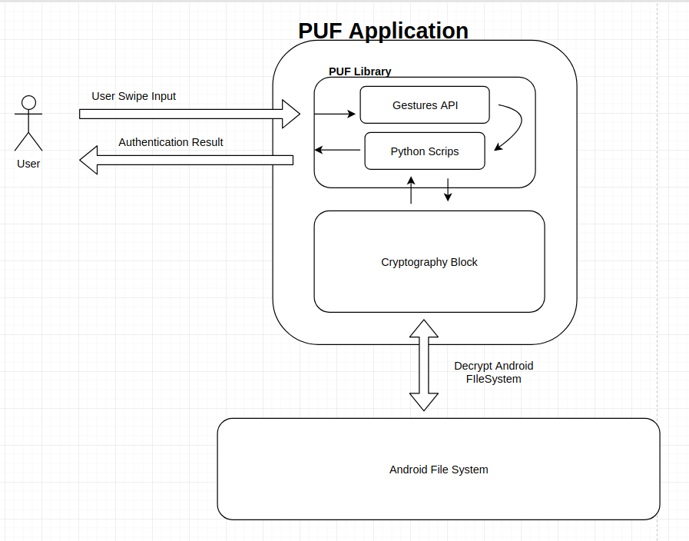
sdmay19-23: Mobile, Biometric Bitlocker
System Design
Python Scripts

Slide 14
sdmay19-23: Mobile, Biometric Bitlocker
PUF Library Decomposition
Gestures API
Will read data from user device gesture interaction
Creates user device pair
Provides challenges
User completes challenges
Challenges create profile
User/device pair created from list of challenges and their responses
Python Scripts
Perform Various Statistical Analyses/Operations
Hamming Distance
Normal Distribution

Slide 15
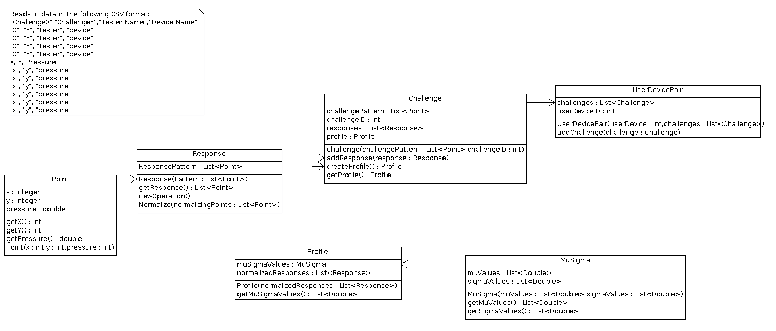
sdmay19-23: Mobile, Biometric Bitlocker
PUF UML

Slide 16
sdmay19-23: Mobile, Biometric Bitlocker
Cryptography Block
Android cryptography API will be used for encryption
Have researched dm-crypt, fscrypt for kernel level
Attempting to mimic TPM (Trusted Platform Module) on computers
End goal is to encrypt at kernel level like Windows Bitlocker (full-disk encryption)
Will start with application level encryption
Will progressively move encryption to lower levels
Feasibility of kernel level encryption is still in question

Slide 17
sdmay19-23: Mobile, Biometric Bitlocker
System Analysis
PUF
Exploits properties of circuitry and manufacturing
User/device pairs are unique on the same models
Eliminates need for special hardware
Eliminates need to store key
User-friendly
Full-disk encryption
More applicable to problem than file based encryption
Introduces questions of feasibility and usability
Notes:
Emphasize reasoning behind uniqueness
All components are slightly different for each device
Takes advantage of miniscule differences between devices

Slide 18
sdmay19-23: Mobile, Biometric Bitlocker
System Requirements
Software
Android Operating System
Minimum Version 5.1 (Lollipop)
Hardware
Should be able to be run on any hardware that is running required Android Version
Device requires a touch screen
Operating Environment
Nexus 7
Notes:
To better control variables in the project, testing is completed on Nexus 7 SDK 23

Slide 19
sdmay19-23: Mobile, Biometric Bitlocker
User Interface
Application prompts pop-up shape to trace
Required authentication to continue access to user app data
Application contains a settings interface
Necessary for managing user profiles

Slide 20
sdmay19-23: Mobile, Biometric Bitlocker
Test Plan
Unit Testing
Designed simultaneously during development
Tests core functionality of a component
Integration Testing
Created when combining between multiple components
Designed to test specific interactions between two components
System Testing
Full operational behavior of the application with actual data
Largely performed towards the end of project

Slide 21
sdmay19-23: Mobile, Biometric Bitlocker
Sample Test Cases
Only authenticated users may access user application data
User A has authentication profile
User A and B complete authentication trace
Only User A with an authentication profile is allowed
Response time of authentication should take less than 5 seconds
User A attempts access and completes the authentication trace
Authentication process notifies result to user A in under 5 seconds

Slide 22
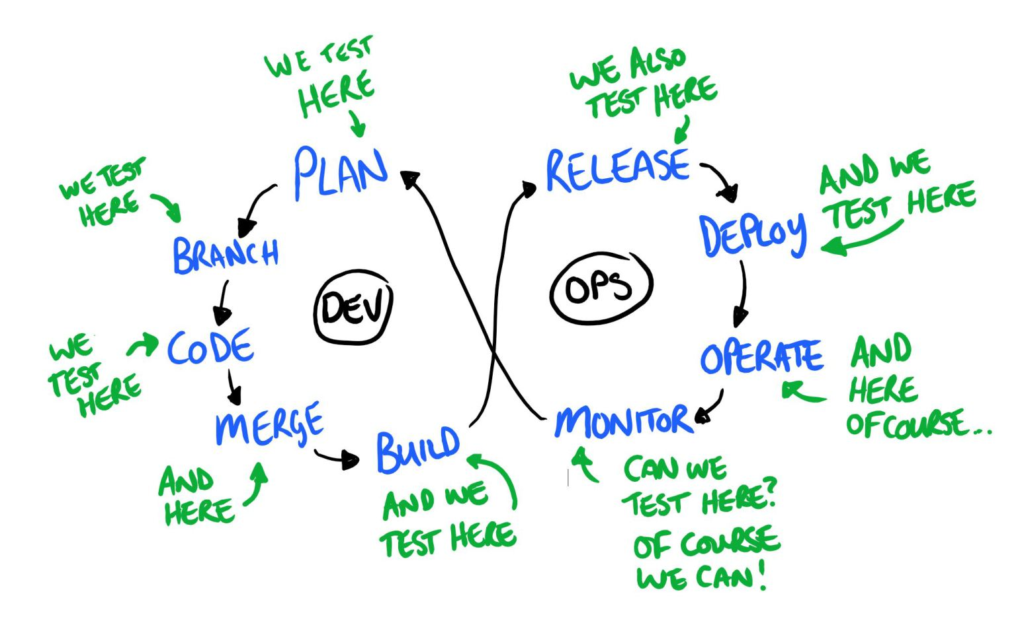
sdmay19-23: Mobile, Biometric Bitlocker
DevOps
Tests:
Pull Requests
Merges to master
Builds:
JAR (PUF)
APK (App)
Deployments:
Google Play Store
Source: https://www.testingexcellence.com/testing-in-devops/

Slide 23
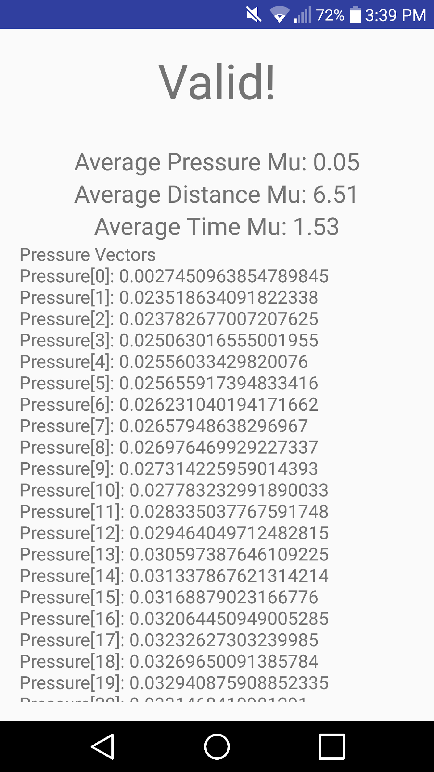
sdmay19-23: Mobile, Biometric Bitlocker
Modeling and Simulation
Android Studio provides an emulator, but it comes with limitations
Physical devices allow for collection of empirical and meaningful data
Notes:
To assist in testing our application, our team decided to use Android Studio to model the layouts and activities throughout the program, which allows us to ensure application’s appearance meets our client’s expectations. Additionally, Android Studio provides an emulator, which allows us to simulate a user using the application and test our functional requirements. Using this form of simulation ultimately allows our team to quickly evaluate program behavior as well as a user’s experience. Unfortunately, this type of emulator comes with limitations in terms of realism. In other words, an emulator does not accurately represent the functionality of the PUF, as it lacks real pressure readings.
So to resolve the issue of realism, our team uses physical Android devices. Using these types of devices allows for the collection of real and meaningful data, ultimately helping us to verify and validate the functionality is working appropriately.
Prototyping and preliminary results aren’t needed because we are building upon a previous team’s implementation to further the integration of our client’s idea

Slide 24
sdmay19-23: Mobile, Biometric Bitlocker
Prototype

Slide 25
sdmay19-23: Mobile, Biometric Bitlocker
Conclusion
Notes:
Our goal for this project is to integrate existing software that details a PUF into an android based OS application. We will do this by research, design, development, testing and conferring with our client. We think this is a worthwhile project because the use of a pressure PUF as a bitlocker for a mobile device has not been done and will add needed security. We hope to complete the application in its entirety by the end of spring 2019.

Slide 26
sdmay19-23: Mobile, Biometric Bitlocker
Current Project Status
Completed Milestones
Completed PUF research
Completed initial design of project
Eliminated extra code from PUF
Integrated PUF into an application design
Notes:
So what is the project looking like right now? Relative to milestones, we have complete the following milestones. We have finished our PUF research, we feel like we have a good handle on what it is. We have also completed our initial design for the project. We removed excess code from the PUF, there was 3000+ extra files that our project didn't need. Lastly we completed a initial integration of PUF into an andriod project.

Slide 27
sdmay19-23: Mobile, Biometric Bitlocker
What did we do?
Yousef Al-Absi / DevOps
Understanding Gradle, PUF issues, DevOps
Cole Alward / Scrum Board Master
PUF issues, application integration, ticket flow
Morgan Anderson / Scribe
Application integration, UI design, meeting notes
Larisa Andrews / Scrum Master
Leading meetings, PUF issues
Ammar Khan / Product Owner
Interacting with client, PUF issues
Justin Kuhn Testing Engineer
Developing test plan, test integration
Notes:
MENTION AGILE
So how can we break down the milestones completed to people. To do this I thought it would be helpful to also talk about our roles. We mostly followed the traditional agile roles for our project. So we have..

Slide 28
sdmay19-23: Mobile, Biometric Bitlocker
Plans for Next Semester
Milestones Started
Fix bugs found in PUF
Implement application encryption
Milestones to be done
Implement kernel level encryption
Identify other things the client might want
Test the application
Notes:
Finally, what do we have to do next semester. Relative to milestones we have started some and have some full tasks left to do. We have started fixing bugs within PUF. We think we know all the issues and have a grasp on how to fix them. We also have started looking into adding encryption to our initial application.
What we have left to do next semester is to implement kernel level encryption, identify other things the client might want, and testing. No neccesarily in that order.

Slide 29
sdmay19-23: Mobile, Biometric Bitlocker
Questions?
Notes:
That's it for us. Do we have any questions?

